Slide 1
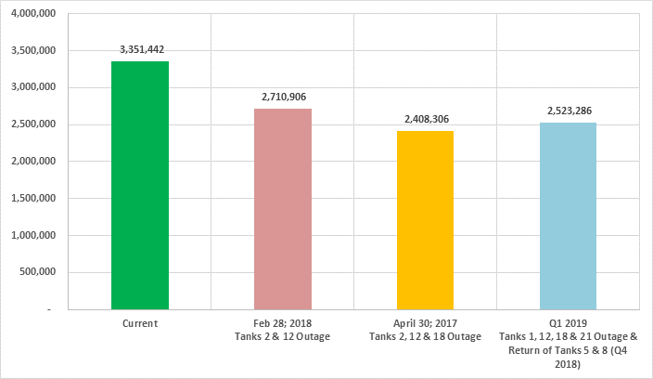
Wave #6577 "Tanks Availability & Operating Ullage Improvement In BOGT
Charter
Background/Scope:
Bonny Terminal receives, dehydrates, stabilizes, stores, and exports SPDC and 3rd Party Eastern crude oil. The terminal has an installed capacity of 7.5MMbbls and current Operating Capacity of 3.35MMbbls. This is made of 20 Crude Oil Storage tanks (10 tanks in service, 10 out of service either awaiting rehabilitation or undergoing rehabilitation)
Of the 10 tanks in service, 3 tanks (Tanks 2; 12 & 21) are either overdue or will be due for rehabilitation . The continued use of the tanks have been via approved deviations post tankpac inspections.
The removal of these tanks from service without introduction of tanks currently undergoing rehabilitation poses a threat of loss of 1.02MMbbls of Ullage for the terminal. There is therefore need to identify all the issues/processes surrounding these tanks and thereafter put in place a framework to address the issues, and develop a framework to maintain a minimum of 3.1MMbbls ullage in the terminal.
Stakeholders:
Omotoso Ireti (Asset Manager)
Njoku Chukwuka (TIM)
Nnajiofor Osita (TIM)
Brossa Isaac
Bob-Manuel Iroloye
Aigboduwa, James
Oseahon, Edmund
David Martins (GMP)
Department Of Petroleum Resources
Federal Government Of Nigeria
Project Team
Brossa Isaac (Lead)
Bob-Manuel Iroloye
Ikechi Amaewhule
Gbadebo Adeboye
Orisunmibare, Lateef
Yemi-Shodimu, Tolu
Amechi, Obinna
Nto, Kalu
Potential Benefits & Measurement:
Cost savings on demurrage of 112,750USD for 500,000 Metric tonnes and above per day; Cost saving on deferment from upstream station average 350kbbl/d
Reduced health impact on personnel called out at upstream facilities for interventions (shut down and start up)
Improve stakeholders relationship
Total cost of addressing issues are estimated at circa F$546k. Full value realisation is expected by May 2018 while initial value from Dec. 2018.
Business Case:
2017 YTD BOGT has experienced about 3 Nos tank top situations. Each tank top situation has below impact:
Potential deferment – complete or partial shutdown of upstream stations for prolonged periods as experienced Feb 15 – 17 and May 28 - 30, 2017 circa 792kbbl (ca. 16kbbls/hr for 48hours)
Loss of revenue from Gas & Crude Oil sales with impact on CSD
Demurrage costs in the case of delay loading of tankers
S&E implications e.g health impact on personnel, increased flaring, etc
Loss of power supply to host community – reputational impact
Actual and potential causes of tank top situations have been identified and listed below..
Late arrival of tankers
Limited ullage availability in terminal
Poor scheduling of tankers.
Deliverables :
Maintainability of 3.1MMbbls (100% availability)
Tank Integrity
Critical Success Factors:
Zero Tank top due to ullage
Stakeholder support
Budget availability
Contracting
Plan:
L0-L1: Cadence opportunity realisation strategy developed for review – Nov 14
L2: Stakeholders engagement, action parties identified and strategy updated – Nov 17
L3: Further expanded & updated strategy planned of stakeholders acceptance and sign–offs Jan-18
L4: Implementation – achieve all deliverables outlined above (items 1 to 4) - March 31, 2018.
L5: Realize value for company - from May, 2018
Initiative End

